Slide 1

College Management System

Slide 2
Introduction
The main aim of this project is to create an android app for managing different activities like updating attendance, managing student & faculty department records in colleges.
The admin or faculty can access the attendance & marks details of their students.
The department can access the details of the faculty .
The admin can access all the details of faculty, student. Summary details will be created and maintained for the students so that they can view their details like their attendance, marks details etc.

Slide 3
Existing System:
In Present all the records are done via paper work.That is taking attendance , managing different records which are done manually.
Attendance, marks or any other info Summary reports are slow.
Time taking.
Students cannot view their attendance or any info at any time required they need to see through record only.

Slide 4
Disadvantages of existing system
It is time consuming
No track of a student’s consolidate results
No effective way to a student’s performance to his/her parent
It leads to error prone results
It needs lots of man power to better the results
Lacks data security
Retrieval of data is time consuming
Less accuracy
Reporting is time consuming

Slide 5
Proposed System:
Managing all department, faculty, student’s information via smart phones.
Replacing Records by entering attendance directly through your smart phones.
Quick summary reports are created and managed.
Student can view their attendance, marks and other information at any point.

Slide 6
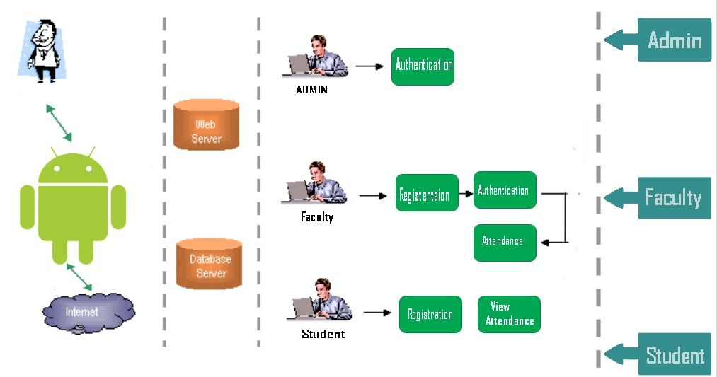
Architecture

Slide 7
Modules ( ADMIN )
Admin is approves the registered faculty.
Admin has a search option for finding any faculty based on their respective faculty ID’s.
Admin can find any student details with his/her roll no.
He is not only responsible for finding an faculty or an student but also access to change the details.

Slide 8
Modules ( FACULTY )
Faculty is registered by the admin
Faculty cannot edit any of his/her information
Faculty has to upload the marks of students whenever they are ready.
A class in-charge can view his/her class’s complete internal and external marks list.
A class in-charge can view his/her class’s attendance performance
Faculty can change his/her password only if he knows the current password
A faculty can search for any student.
A faculty can access any student’s personal information, internal marks, attendance, consolidate results

Slide 9
Modules ( STUDENT)
Each student’s username is his/her own roll number.
Each student is given a default password at the time of admission
A student can change password provided that he knows his previous password
A student can check his/her personal information
Can check their consolidate results.
A student cannot have any permission to edit any information in the database except his own password.

Slide 10
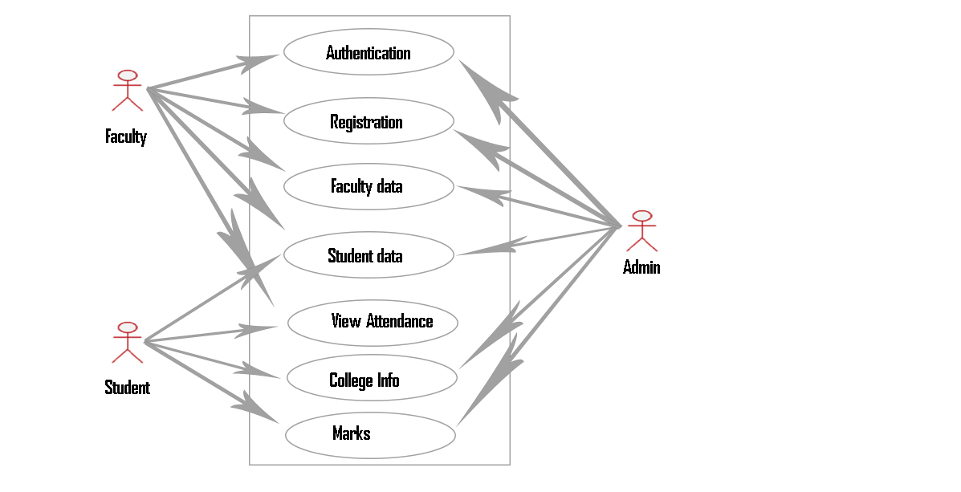
Use Case Diagram

Slide 11
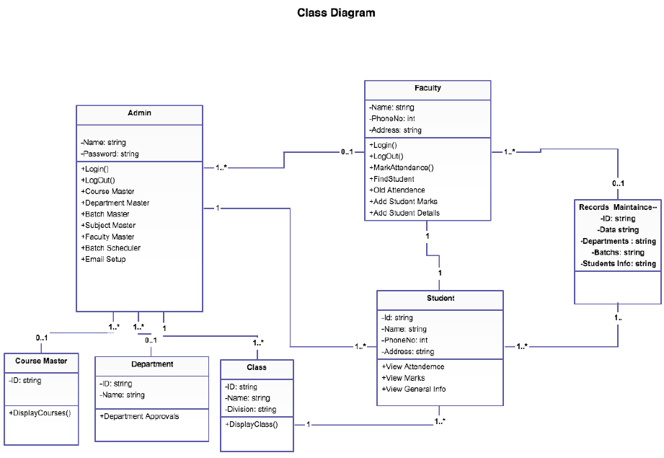

Slide 12

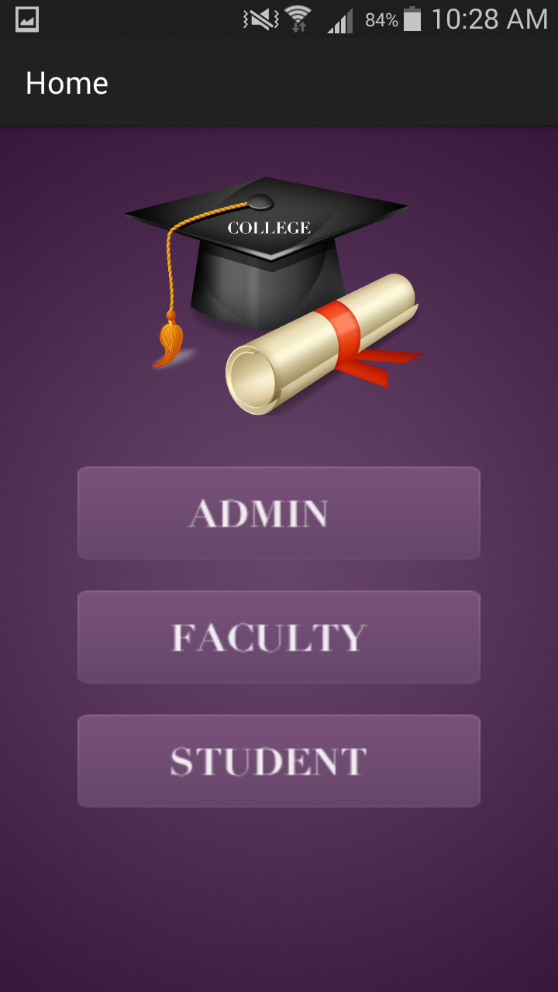
Snapshots

Slide 13
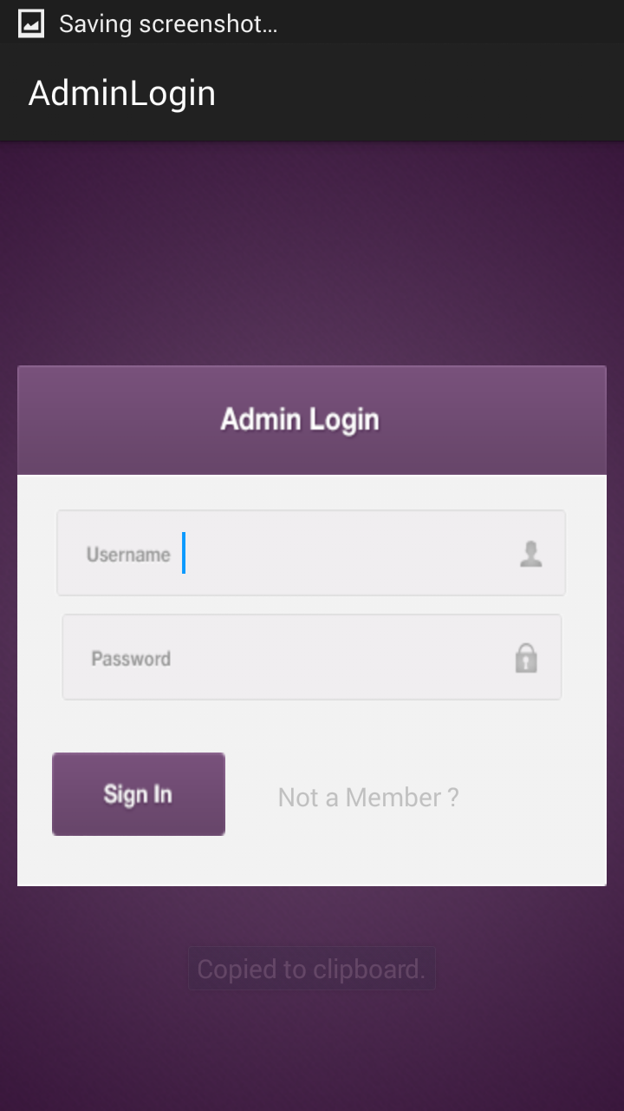
Snapshots (Admin)

Slide 14
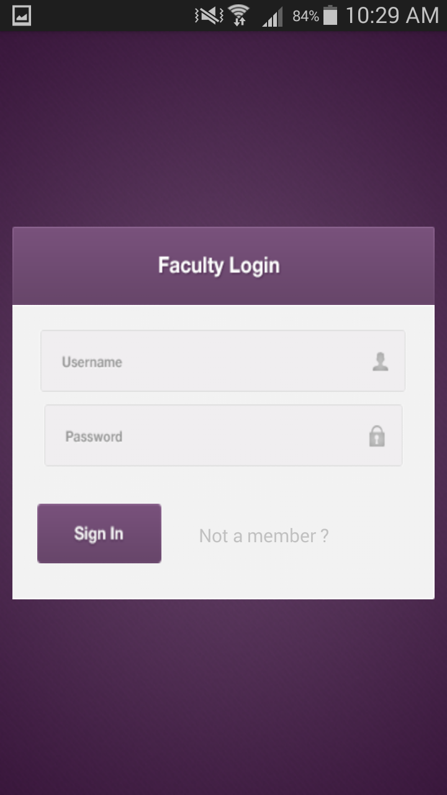
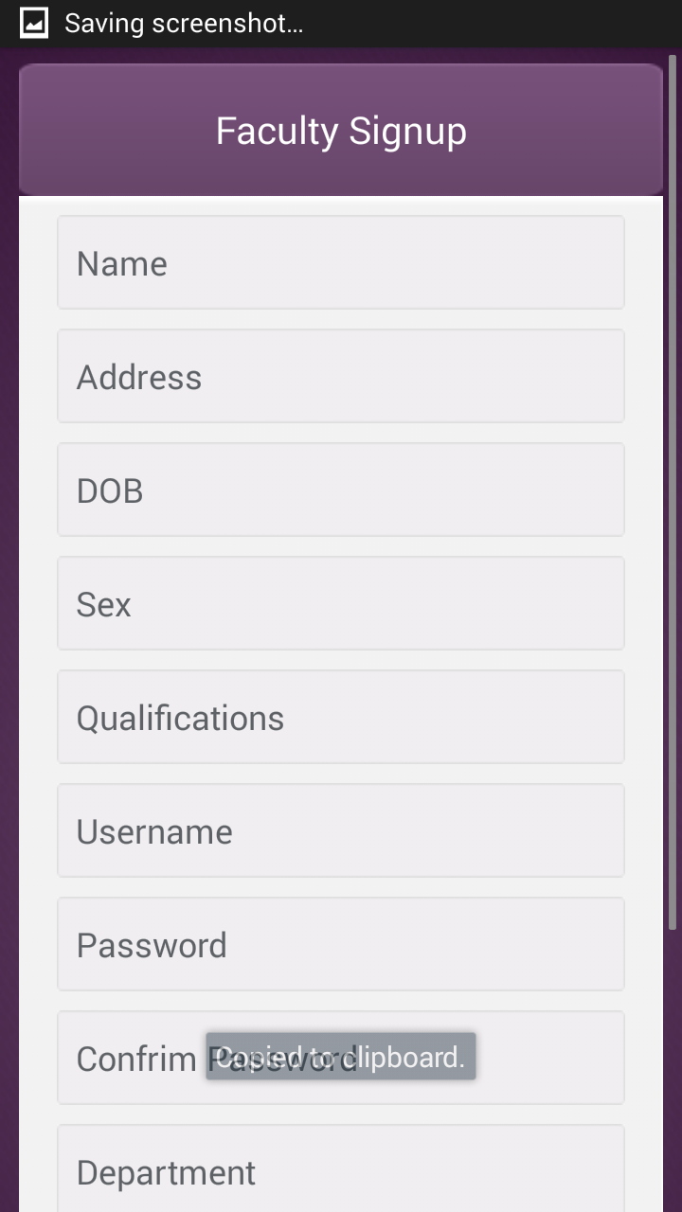
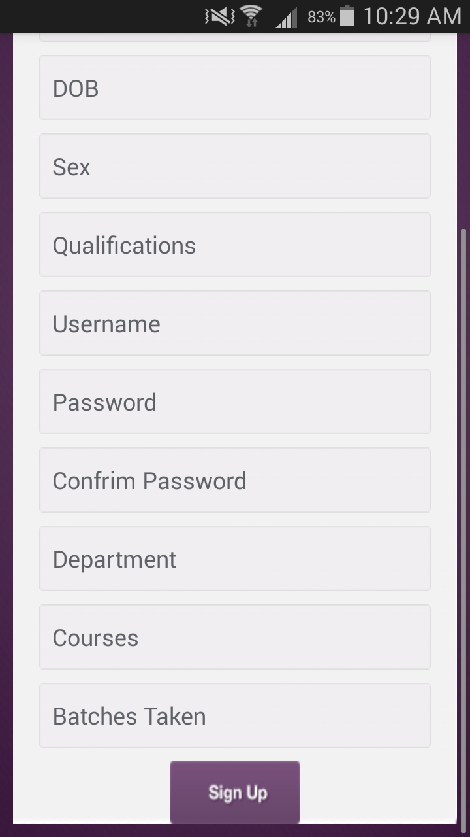
Snapshots (Faculty)

Slide 15
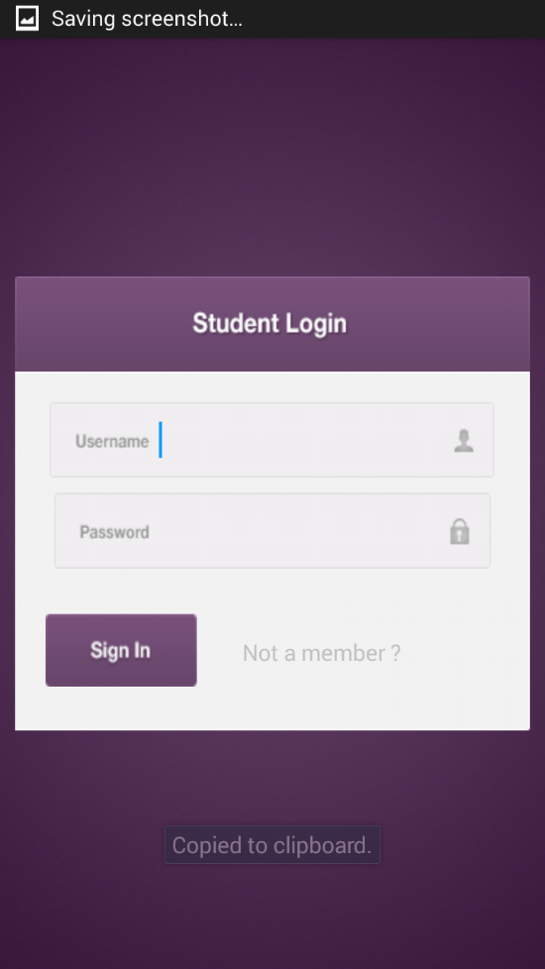
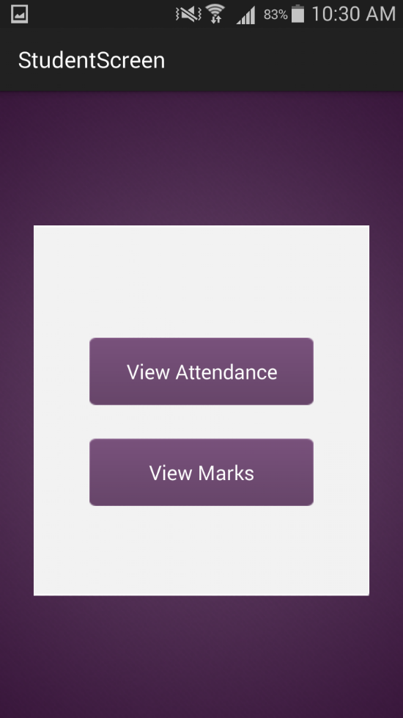
Snapshots (Student)

Slide 16
System Configuration
Software requirements:
Programming Language : Java
Web based Technologies : XML, CSS, PHP
Parser : JSON Parser
Database Connectivity : MYSQL
Java Version : JRE: 6 , JDK : 8
IDE : Android Studio
Backend : PHP, MYSQL
Operating System : Windows 8/7/Vista/2003
Emulator : Intel HAXM
Others : At least 1 GB for Android SDK
Emulator system images,Caches.
Output Screen : AVD , Smart Phone

Slide 17
System Configuration
Hardware Requirements
Intel Pentium 4 1.5GHz or more
2 GB RAM minimum
500 MB Hard Disk or more

Slide 18

Thank You !!
)

